Slide 1
Smart Street Light System
By:
Vusirikala Hari Kiran(15131A05M4) UnderGuidence of:
Yaswanth Sai Pulavarthi(15131A05N0) Ms.Lateefa Shaik
Vaddi Siri Varsini(15131A05L3)
Rongala Surya Sai Teja(15131A05I2)

Slide 2
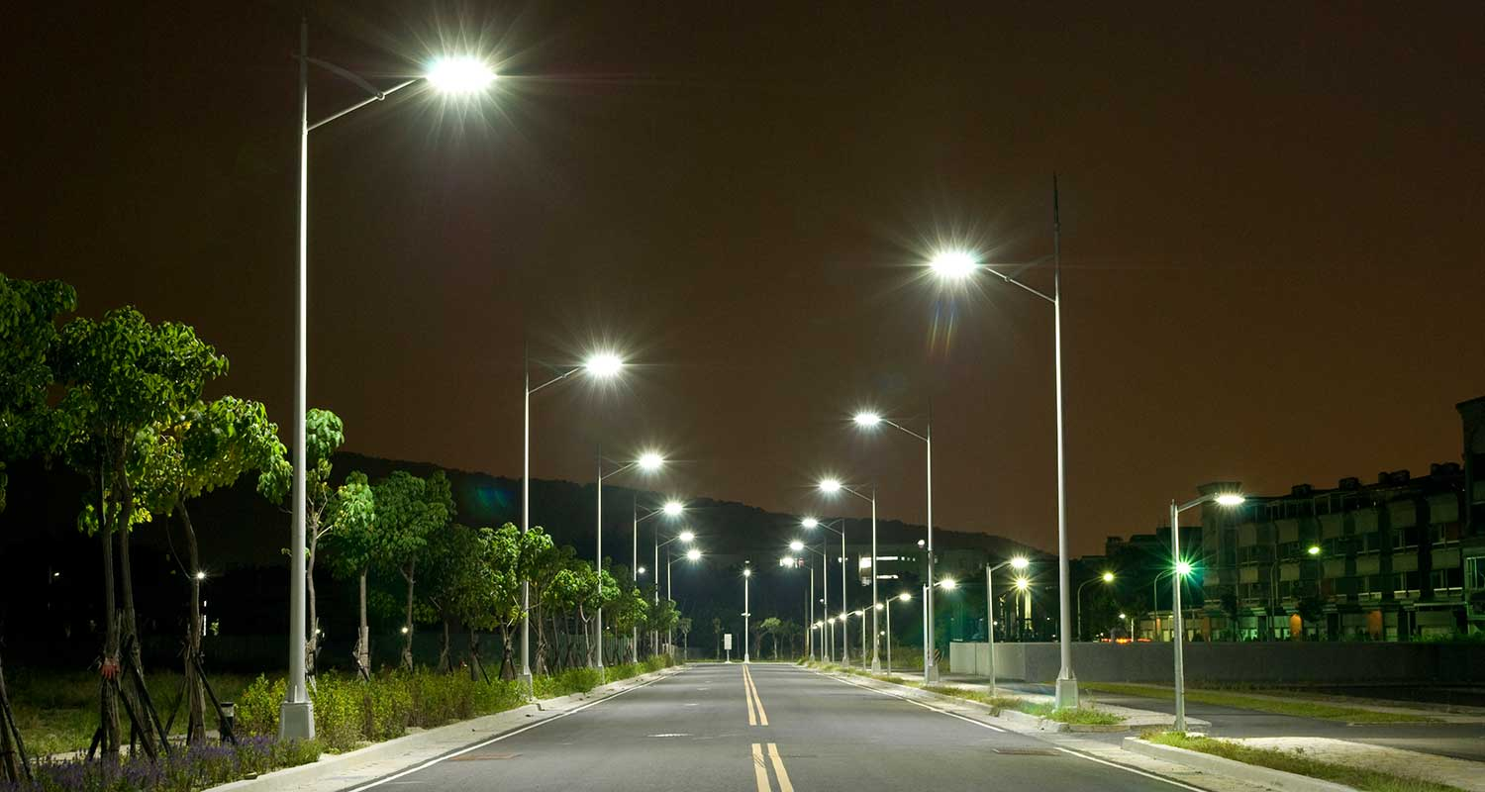
Contents
Introduction
How it works
Main Components
About the component
Circuit Diagram
Advantages
Disadvantages
Conclusion
Reference

Slide 3
Abstract
The main purpose of this project is to switch ON and OFF street lights without manual operation.
By using this system energy consumption is reduced.
IR sensors and LDR sensor are the main components of the project.
IR sensor is like our eye which detect the presence of an object.

Slide 4
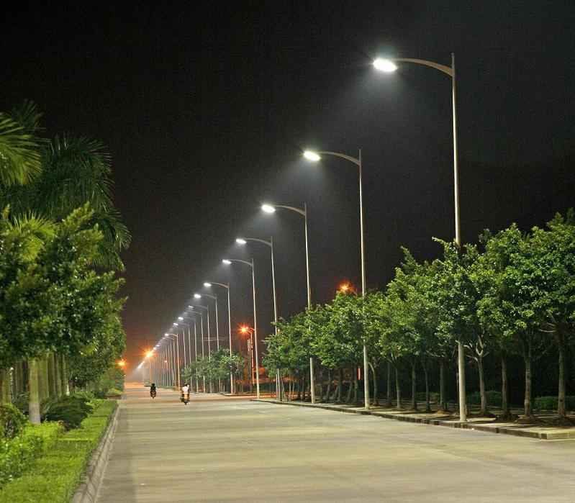
Introduction
Reducing the wastage of power
The aim of automated streetlight management system using IOT is the conservation of energy by reducing electricity wastage.
In the field of electronics automated
systems are giving good performances

Slide 5
How it works
Initially the street lights will work with certain intensity of light which can be fixed.
Street lights will work only when vehicles pass on through the street lights using IR sensor.
This whole system will work only in the absence of sunlight making use of the LDR sensor.
In this system the street lights at the turnings are always made glow with max intensity to decrease the road accidents while making the turnings.

Slide 6
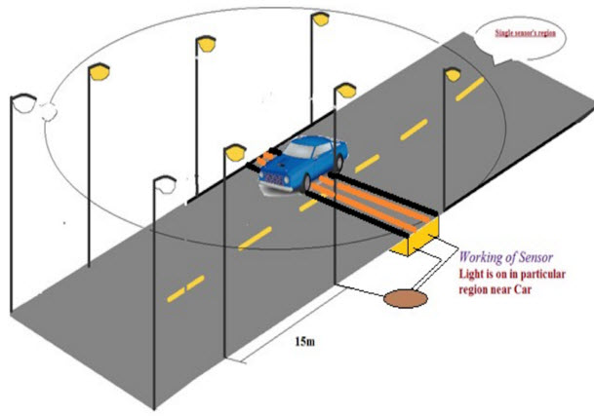

Slide 7
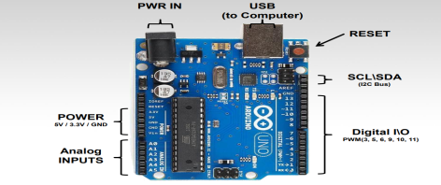
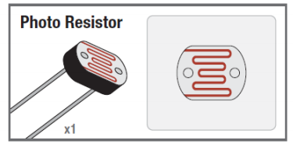
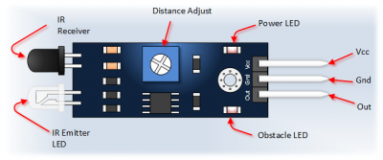
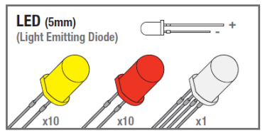
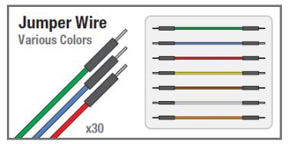

Main Components
Arduino UNO
LDR Sensor
IR Sensor
LED Lamps
Jumper Wire
Wire
Cable

Slide 8
Arduino
The Arduino Uno is a microcontroller board based on the ATmega328 (datasheet).
It has 14 digital input/output pins (of which 6 can be used as PWM outputs), 6 analog inputs, a 16 MHz ceramic resonator, a USB connection, a power jack, an ICSP header, and a reset button.
Simply connect it to a computer with a USB cable or power it with a AC-to-DC adapter or battery to get started

Slide 9
About the components
IR sensor:
Infrared Obstacle Sensor Module has built-in IR transmitter and IR receiver that sends out IR energy and looks for reflected IR energy to detect presence of any obstacle in front of the sensor module.
The module has on board potentiometer that lets user adjust detection range

Slide 10
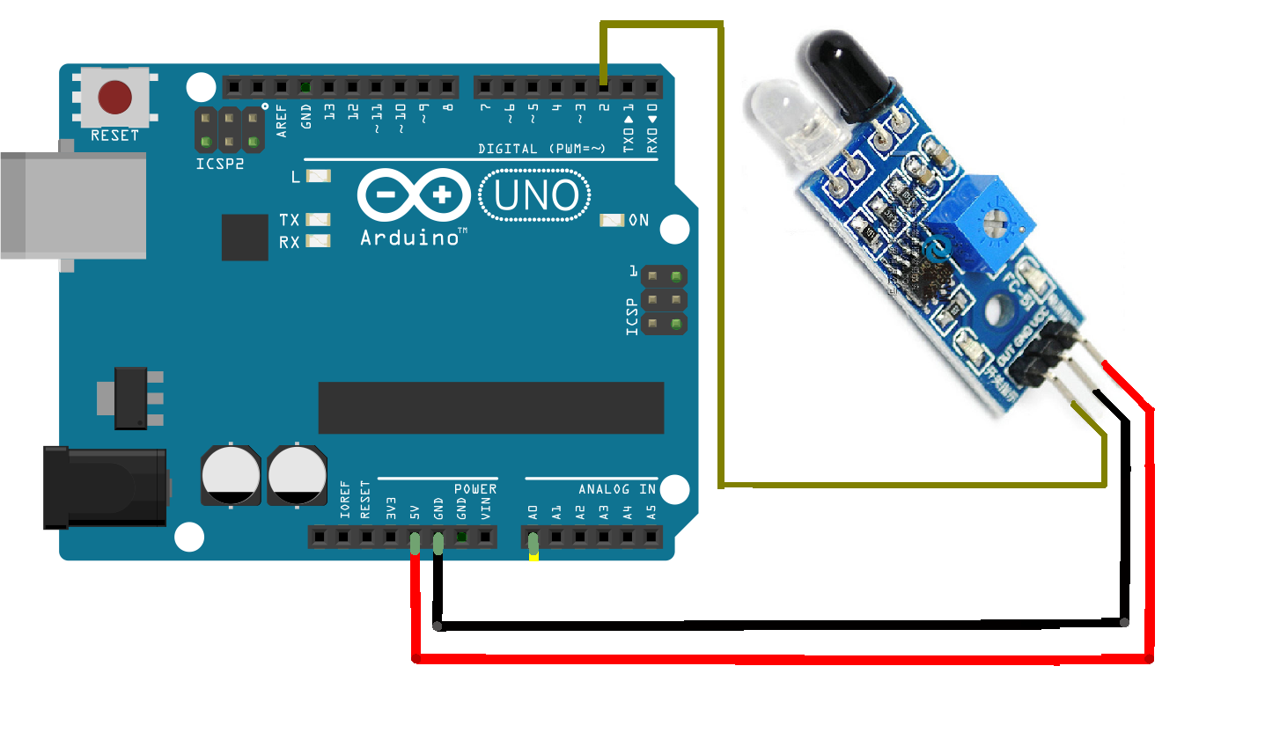

Slide 11
LDR(Light Dependent Resistor)
An electronic component whose resistance decreases with increase of incident intensity.
LDR is a light-controlled variable resistor.

Slide 12
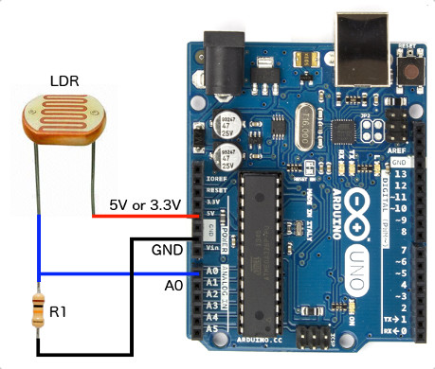

Slide 13
Jumper Wires
A jump wire is an electrical wire, or group of them in a cable, with a connector or pin at each end
It is normally used to interconnect the components of a breadboard or other prototype or test circuit, internally or with other equipment or components, without soldering

Slide 14
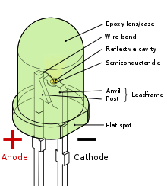
LED’S(Light Emitting Diodes)
An light-emitting diode(LED) is a semiconductor light source.
LED’s are used a indicator lamps in many devices,and are increasingly used for lighting.

Slide 15
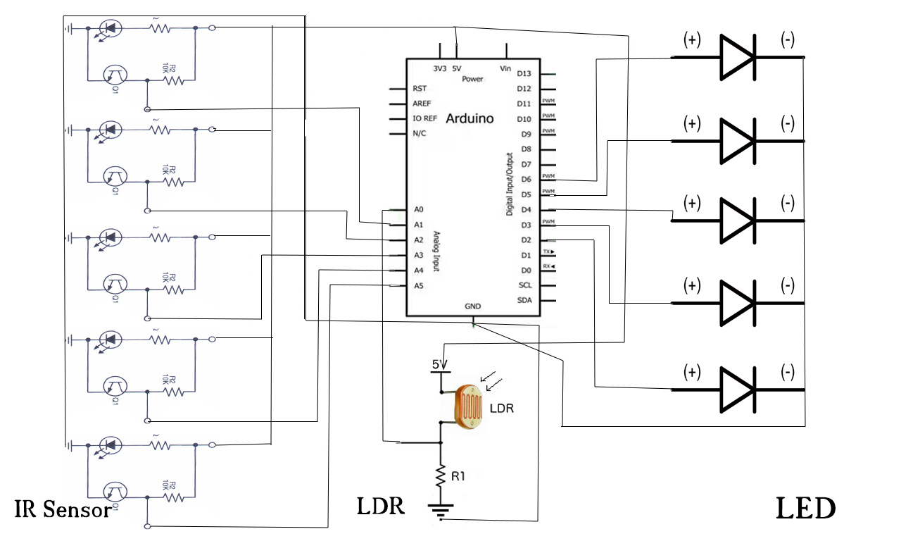
Circuit Diagram

Slide 16
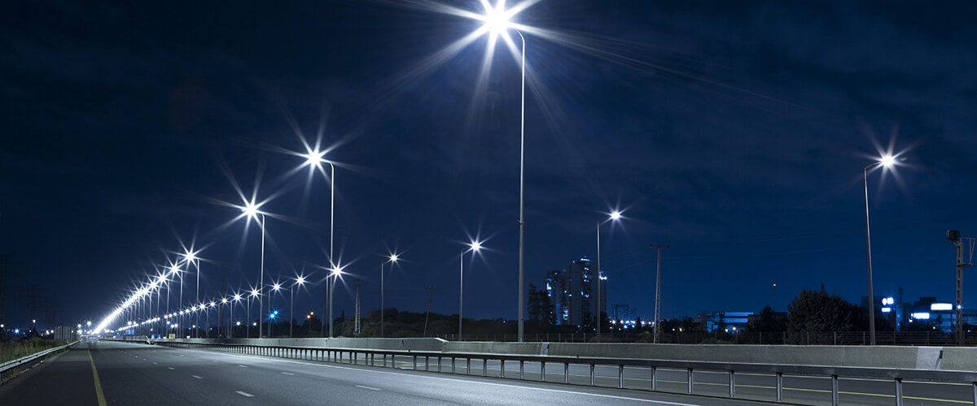
Advantages
Energy Savings
Low cost
Safety and Security
Automated operation

Slide 17
Disadvantages
It has a Limitation of power
Light turns on when shadow falls on LDR
LED is a low voltage device

Slide 18
Conclusion
In coming days this will prove a great boon to the country since it will save lot of electricity of power plant that gets wasted in illuminating the street lights.
As a conclusion around 80% of power consumption can be reduced by using this system towards providing a solution for energy saving.

